Slide 1


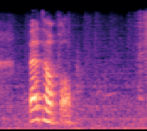
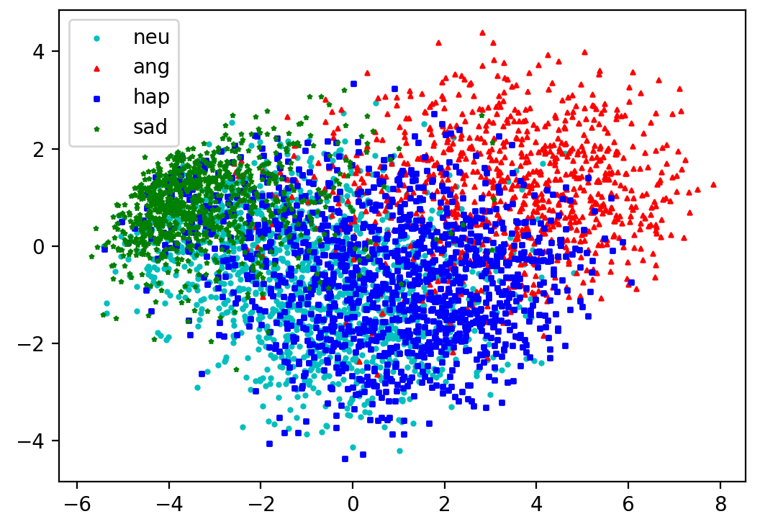
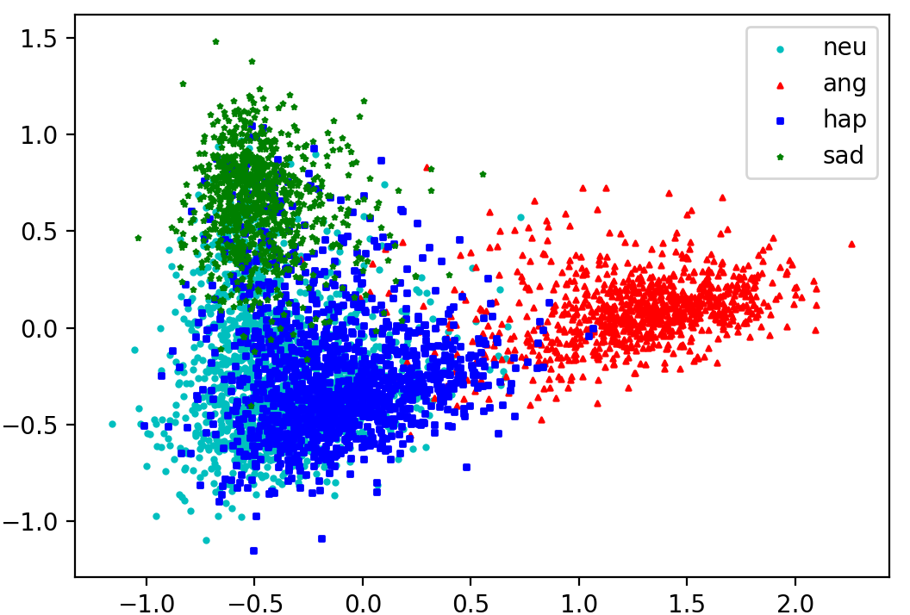
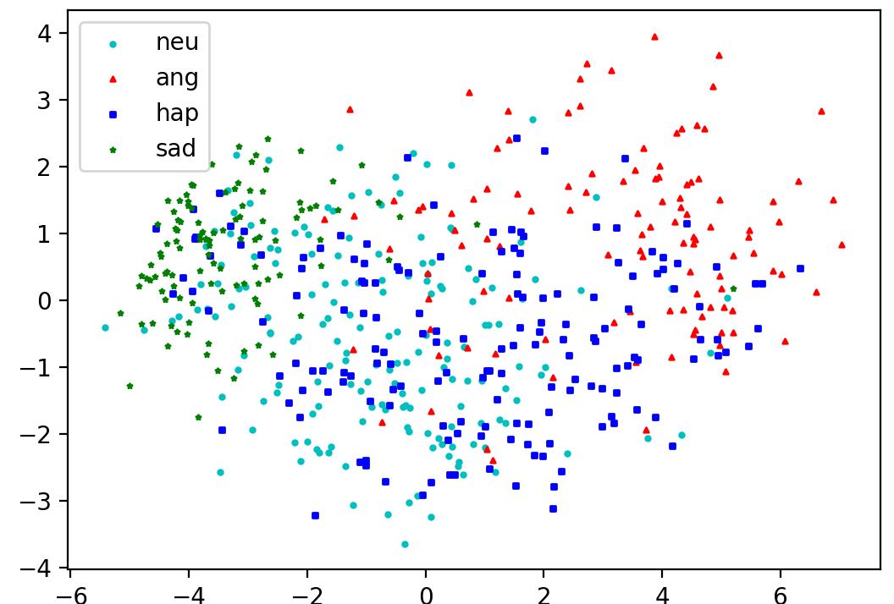
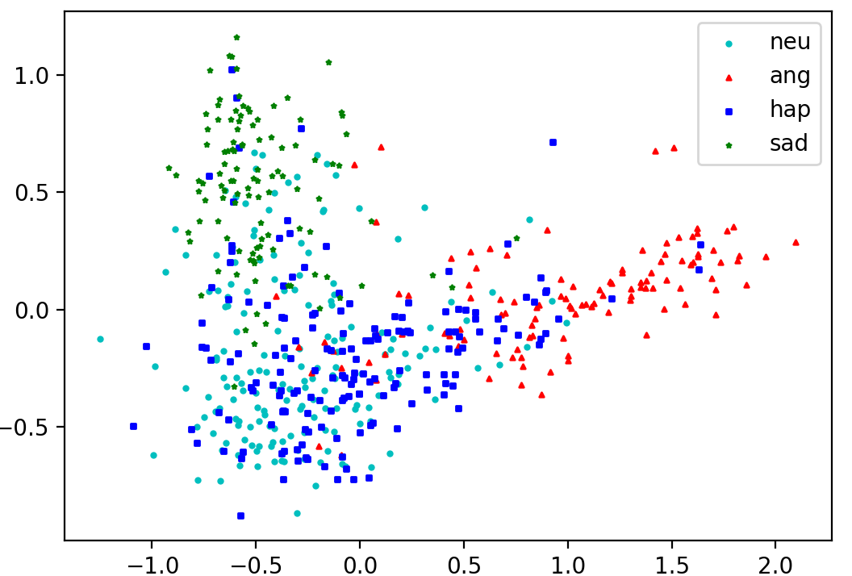


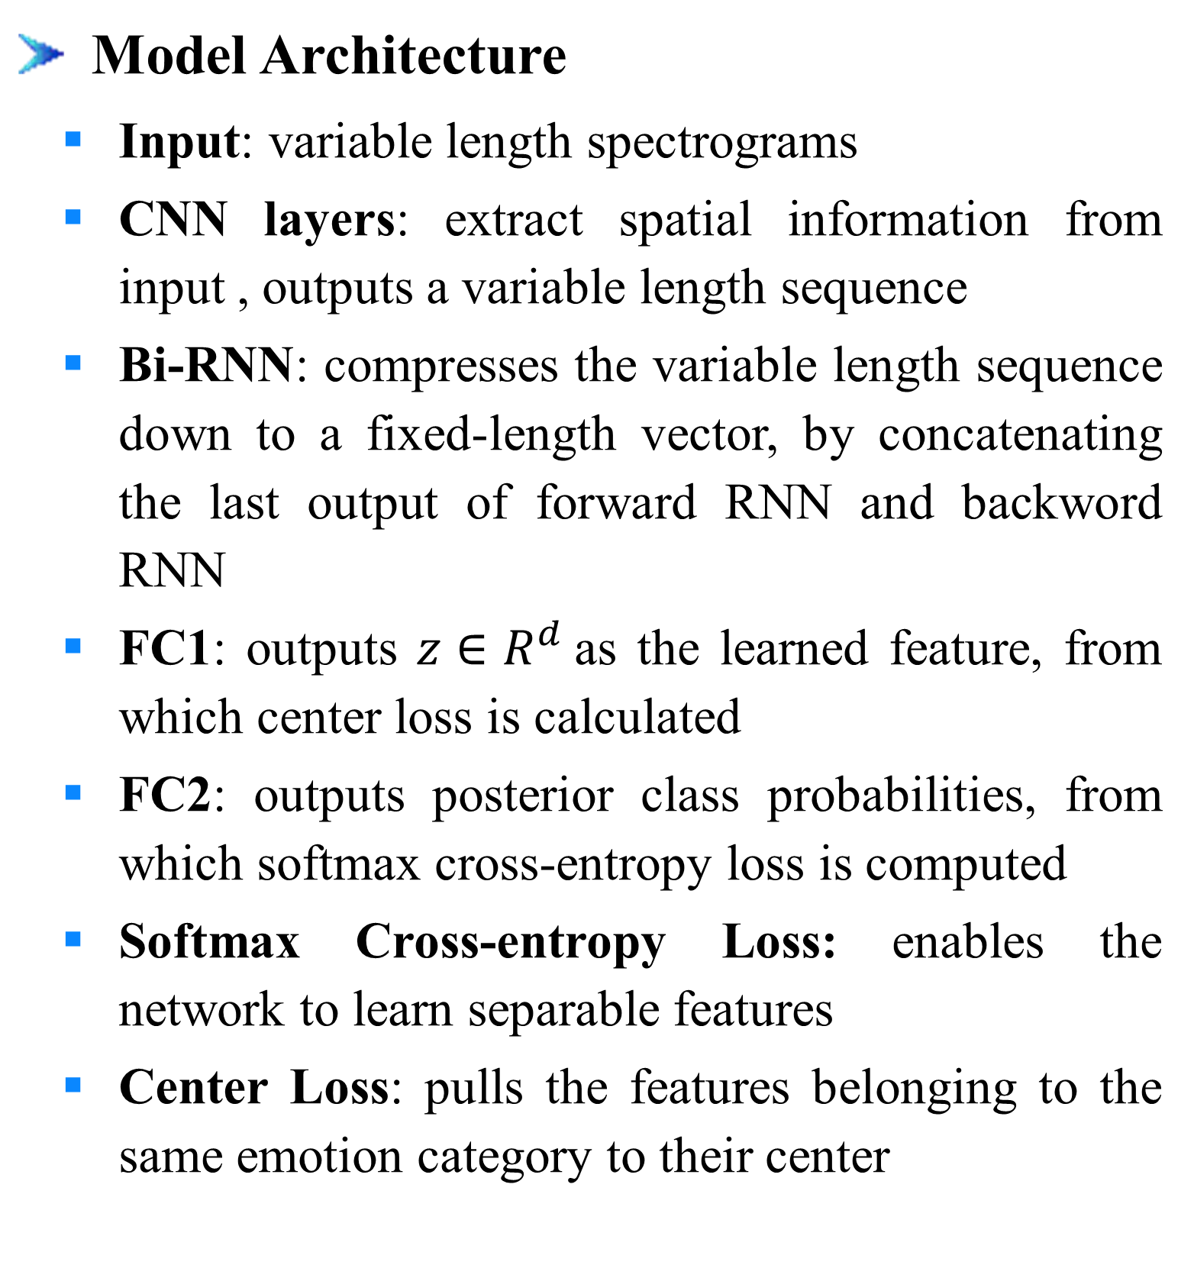
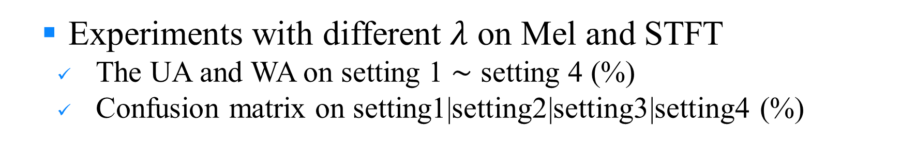


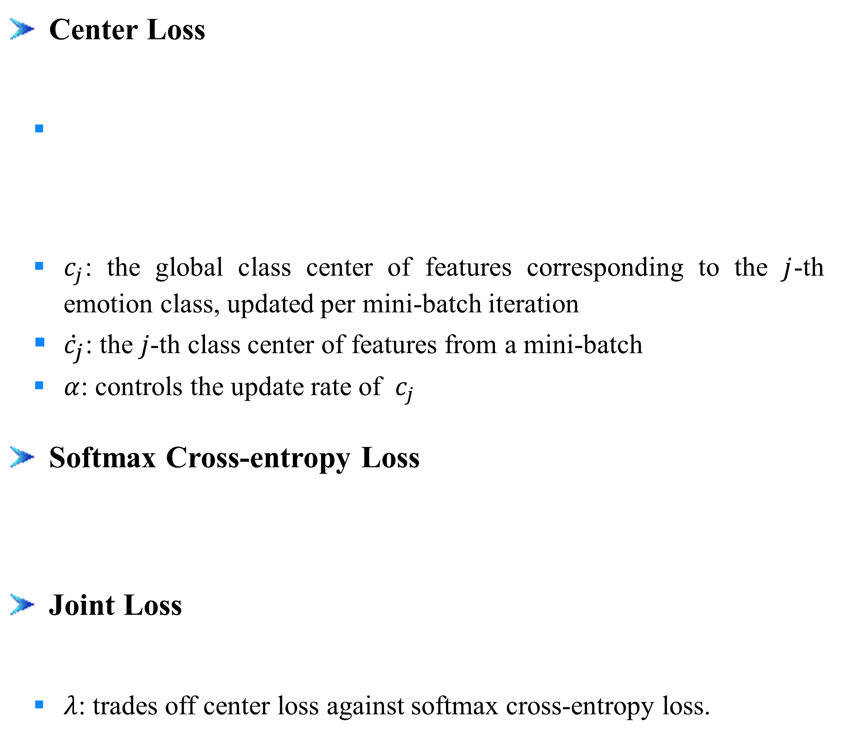

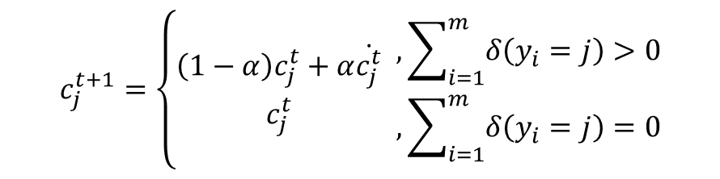





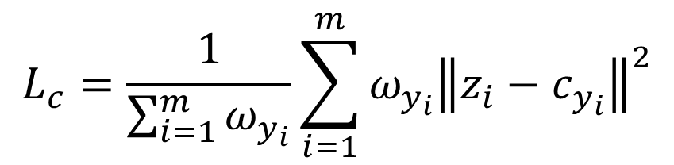



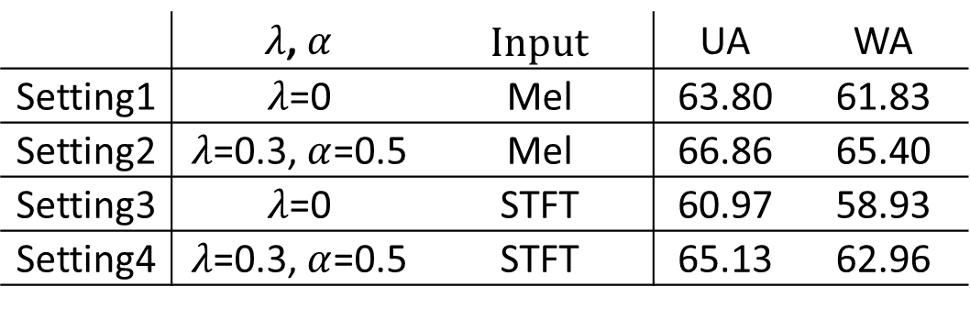

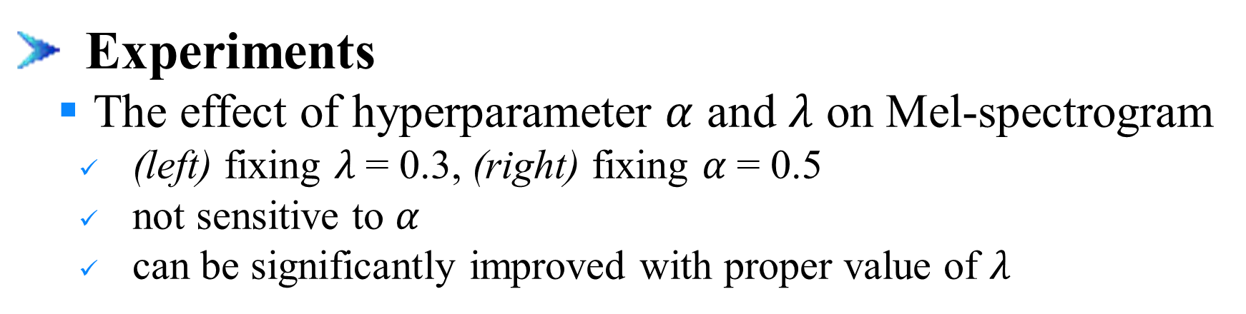
Learning Discriminative Features from Spectrograms using Center Loss for Speech Emotion Recognition
Dongyang Dai^{1,2}, Zhiyong Wu^{1,2,3}, Runnan Li^{1,2}, Xixin Wu³, Jia Jia^{1,2}, Helen Meng^{1,3}
¹Tsinghua-CUHK Joint Research Center for Media Sciences, Technologies and Systems, Graduate School at Shenzhen, Tsinghua University, Shenzhen, China ² Tsinghua National Laboratory for Information Science and Technology (TNList), Department of Computer Science and Technology, Tsinghua University, Beijing, China
³ Department of Systems Engineering and Engineering Management, The Chinese University of Hong Kong
1. Introduction
2. Proposed Method
Motivation
Identify emotions directly from raw data (spectrograms), getting rid of feature engineering
Extract discriminative features with larger inter-class variance and smaller intra-class variance to improve performance
Center Loss
Model Architecture
Input: variable length spectrograms
CNN layers: extract spatial information from input , outputs a variable length sequence
Bi-RNN: compresses the variable length sequence down to a fixed-length vector, by concatenating the last output of forward RNN and backword RNN
FC1: outputs $z∈R^{d}$as the learned feature, from which center loss is calculated
FC2: outputs posterior class probabilities, from which softmax cross-entropy loss is computed
Softmax Cross-entropy Loss: enables the network to learn separable features
Center Loss: ﻿pulls the features belonging to the same emotion category to their center
$$L_{c}=\frac{1}{\sum_{i=1}^{m}{ω_{y_{i}}}}\sum_{i=1}^{m}{ω_{y_{i}}{\left\|z_{i}−c_{y_{i}}\right\|}^{2}}$$
$$z$$
+
Input
Softmax Cross-entropy Loss
$$c_{j}^{t+1}=\left\{\begin{aligned}\left(1−α\right)c_{j}^{t}+α\dot{c_{j}^{t}} \\ c_{j}^{t}\end{aligned}\begin{matrix} , \sum_{i=1}^{m}{δ\left(y_{i}=j\right)>0} \\ ,\sum_{i=1}^{m}{δ\left(y_{i}=j\right)=0}\end{matrix}\right.$$
CNN-layers
Bi-RNN
FC1
Spectrograms
Discriminative Features
Emotion
FC2
Reshape output: ${L′}_{T} ×d_{cnn} { (d_{cnn}=96⋅d′}_{T}$)
Center Loss
$c_{j}$: the global class center of features corresponding to the $j$-th emotion class, ﻿updated per mini-batch iteration
${\dot{c}}_{j}$: ﻿the $j$-th class center of features from a mini-batch
$α$: controls the update rate of $c_{j}$
Softmax Cross-entropy Loss
Joint Loss
$λ$: ﻿trades off center loss against softmax cross-entropy loss.
Challenge
How to design suitable model processing variable length spectrograms
How to propose an appropriate method to extract discriminative features
Contribution
Apply CNN + Bi-RNN extracting features directly from spectrograms
Introduce center loss together with softmax cross-entropy loss in SER task to learn discriminative features
Separable inter-class features
More compact intra-class features
Reshape(Keep time axis)
2D convolutions output: ${L′}_{T} × L_{F}^{′}×$96
Concatenate
Max-pooling: 2 $×$ 2, strides [2, 2]
Convolution: 96 filters of 3 $×$ 3, strides [1, 1]
Max-pooling: 2 $×$ 2, strides [2, 2]
Convolution: 80 filters of 3 $×$ 3, strides[1, 1]
Max-pooling: 2 $×$ 2, strides [2, 2]
Convolution: 64 filters of 3 $×$ 3, strides [1, 1]
Convolution: 48 filters of 7 $×$ 7, strides [2, 2]
Input: spectrogram L_{T} $× L_{F}$
Bi-RNN
CNN layers
3. Experiments and Results
4. Conclusion
Experimental Setup
Dataset: IEMOCAP
4 emotion categories: neutral, angry, happy and sad (happy and excited merged as happy)
﻿﻿﻿5 subsets
Randomly divided the total 5531 utterances, but keeping the distribution portion of emotion categories
4 subsets for training, half of the last subset as development set and half as test set
Settings of spectrograms
Model input: log scale STFT spectrogram or Mel-spectrogram
Hamming window: 40ms window length and 10ms shift
Sample rate: 16KHz
DTF length: 1024
The number of Mel bands: 128
Evaluation metrics
Unweighted Accuracy (UA): the mean value of the recall for each class
Weighed Accuracy (WA): the number of correctly classified samples divided by the total amount of samples
Experiments
The effect of hyperparameter $α$ and $λ$ on Mel-spectrogram
(left) fixing $λ$= 0.3, (right) fixing $α$= 0.5
﻿not sensitive to $α$
﻿can be significantly improved with proper value of $λ$
Conclusion
Introducing center loss with proper $λ$ could effectively improve the SER performance on both STFT spectrogram and Mel-spectrogram input
Mel-spectrogram input, reducing the dimension based on human hearing characteristics, outperforms STFT spectrogram input
﻿The 2-D PCA embedding illustrates the discriminative power of using center loss, ﻿which enables the neural network to learn more effective features for SER
﻿﻿ Experiments with different $λ$ on Mel and STFT
﻿The UA and WA on setting 1 $∼$ setting 4 (%)
Confusion matrix on setting1|setting2|setting3|setting4 (%)
 | ﻿$λ$,$α$ | ﻿Input | UA | WA
Setting1 | $λ$=0 | Mel | 63.80 | 61.83
Setting2 | $λ$=0.3,$α$=0.5 | Mel | 66.86 | 65.40
Setting3 | $λ$=0 | STFT | 60.97 | 58.93
Setting4 | $λ$=0.3,$α$=0.5 | STFT | 65.13 | 62.96
 | neu | ang | hap | sad | neu | ang | hap | sad | neu | ang | hap | sad | neu | ang | hap | sad
neu | 57.5 | 9.5 | 16.4 | 16.6 | 63.7 | 6.7 | 16.7 | 12.7 | 54.4 | 9.3 | 18.5 | 17.7 | 57.3 | 7.3 | 19.6 | 15.7
ang | 11.9 | 69.1 | 15.5 | 3.5 | 10.8 | 70.5 | 16.7 | 2.0 | 12.7 | 68.1 | 16.7 | 2.5 | 10.3 | 72.0 | 15.3 | 2.2
hap | 21.1 | 16.2 | 51.1 | 11.5 | 21.9 | 13.1 | 55.6 | 9.4 | 21.6 | 18.6 | 47.6 | 12.2 | 20.5 | 16.1 | 51.8 | 11.4
sad | 13.8 | 2.6 | 6.0 | 77.6 | 12.8 | 2.5 | 7.0 | 77.7 | 16.1 | 3.9 | 6.2 | 73.7 | 12.5 | 2.8 | 5.3 | 79.3
﻿﻿ PCA embedding of feature $z$: ﻿(a) training set on setting 1, (b) training set on setting 2, (c) test set on setting 1, (d) test set on setting 2
5. Acknowledgment
This work is supported by National Natural Science Foundation of China (NSFC) (61433018, 61375027), joint research fund of NSFC-RGC (Research Grant Council of Hong Kong) (61531166002, N CUHK404/15) and National Social Science Foundation of China (13&ZD189)
(a)
(b)
(c)
(d)

